Slide 1

Welcome to Tom and Jerry Play school

Slide 2
Our Team Moto
Our Motto is to promote the Joy of learning.
Joy of learning develops a well adjusted person who has a purpose and direction in his/her life. Children who experience the joy of learning, are happy, confident, fulfilled children.
Mrs. Khushbu Agrawal
Mrs. Shefali Shrivastava

Slide 3
Why Tom and Jerry
The most important benefits of sending your kid to Tom and Jerry :
Mode of Preparation for School: In the initial days, child often exhibits various fussy and demanding attitudes. The first step is to train kids to face the world. There would be a change in children’s behaviour and nature . Knowledge of Social Life: Kids get chance to mingle with other school mates by attending Tom and Jerry. A sense of situation handling power is developed among the children. Through play school education child is able to get sufficient knowledge about the society. Interaction with other Kids: Child gets chance to interact and converse with other children. With the demand of the time, he/she learns to enjoy the company of other children of the same age group. Kids get chance to improve their mental ability and growth by the help of Tom and Jerry. Learn While You Play : Children are very imitative in nature. Playschools normally put importance on playing at school. Their teaching learning process are based on learn and fun principles. Children are normally taught nursery rhymes and other lessons for knowing the real world round them.
Reduction of Separation: By indulging kids into various entertaining and creative activities, the play schools are able to create some sort educational orientation among the children. In this way children start detaching from their parents and concentrate on learn and fun activities provided by the pre schools.

Slide 4
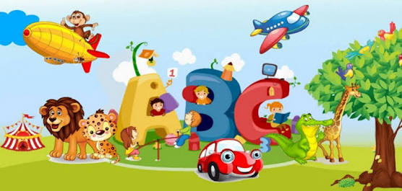
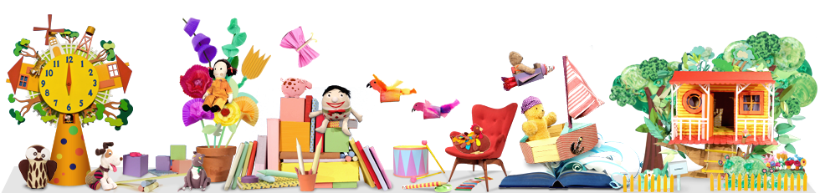
A Day in Tom and Jerry Play

Slide 5
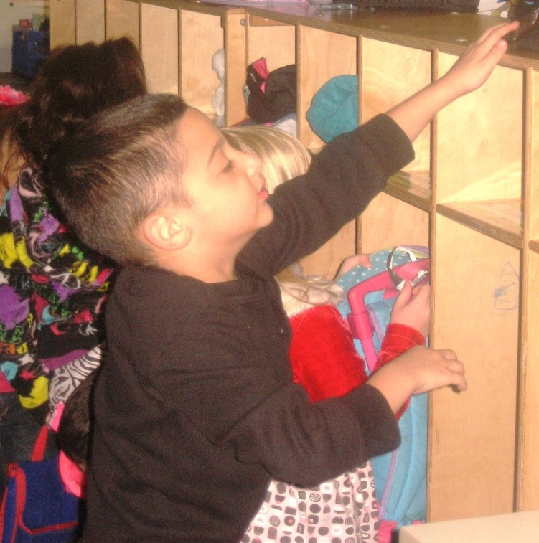
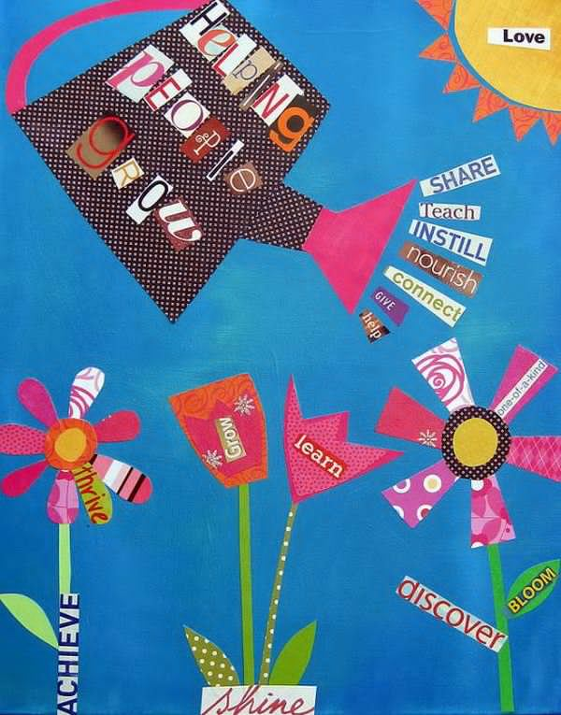
Good Morning !!!
The children arrive at school and get themselves ready for the day.
Allowing children to do things by themselves fosters independence and gives them a sense of pride.
Notes:
Travel to/from school - bus, car

Slide 6
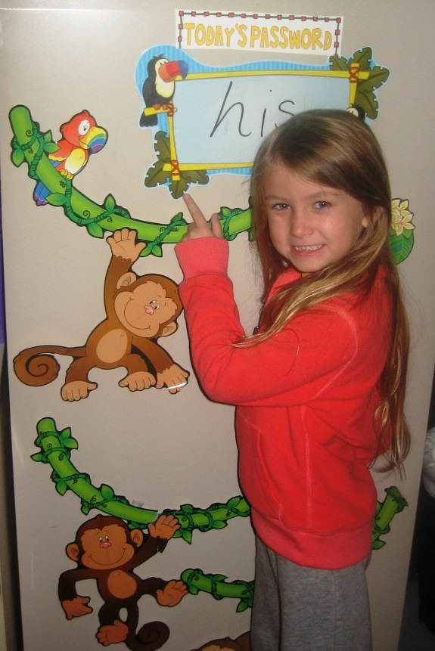
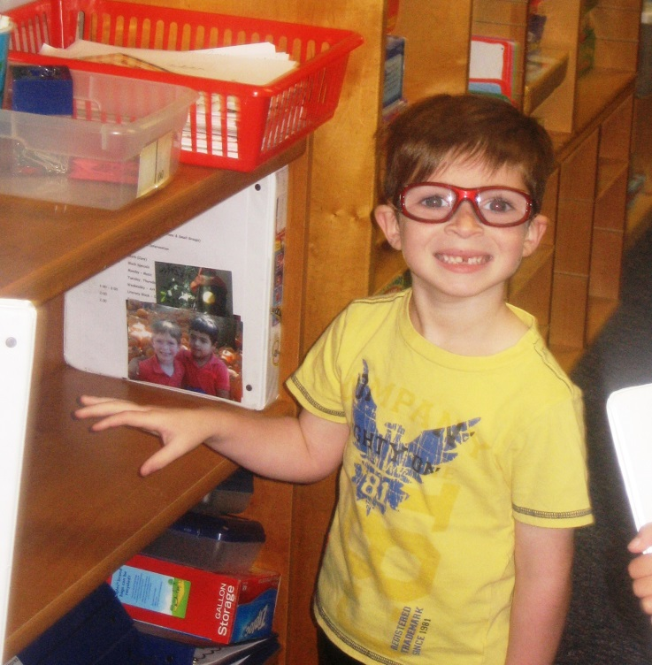
Morning Routine
Having a consistent arrival-time routine helps the children transition from home to classroom.
Daily jobs such as signing in and answering the question of the day foster responsibility and create a sense of community.
Notes:
Morning jobs - fostering responsibility

Slide 7
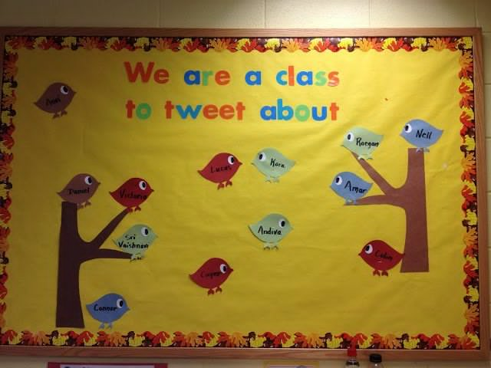
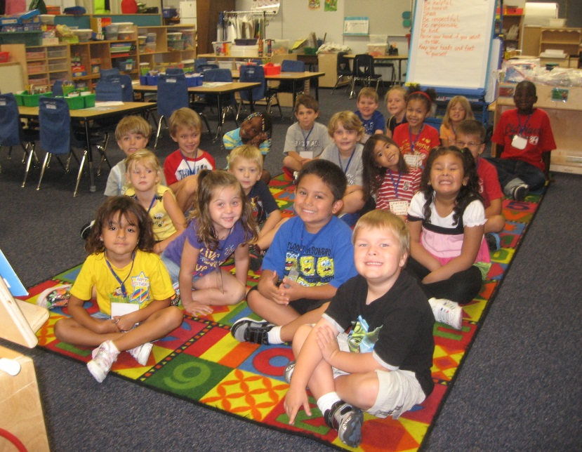
Morning Meeting
We start each day with a personal greeting for every student. We do the morning Prayer and recite our classroom rules. This is also a time to review the schedule for the day and talk about what we will be learning that day.
Notes:
Morning Meeting / Calendar / Weather / Days of School

Slide 8
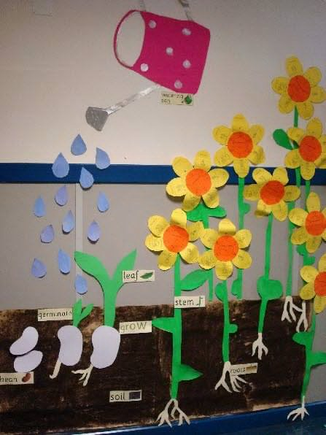
Tom and Jerry Literacy Block
Readers Workshop
Shared Reading
Guided Reading
Interactive Writing
Read-A louds
Literacy Centers
Writing Workshop

Slide 9
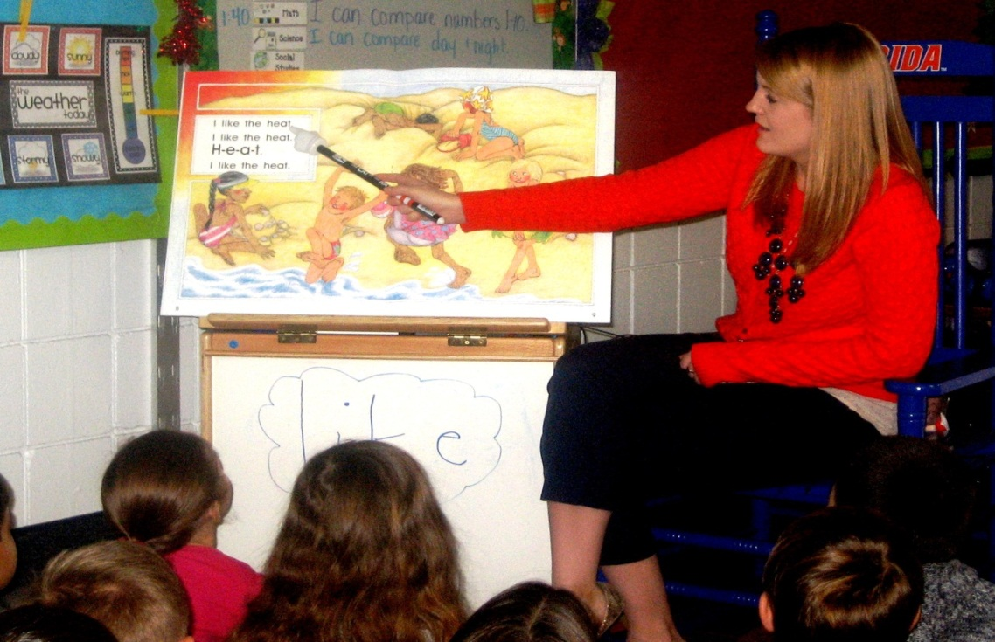
Shared Reading
During shared reading, the teacher and children read big books and poems.
Notes:
Shared Reading

Slide 10
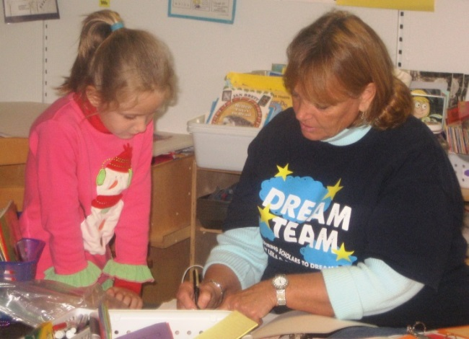
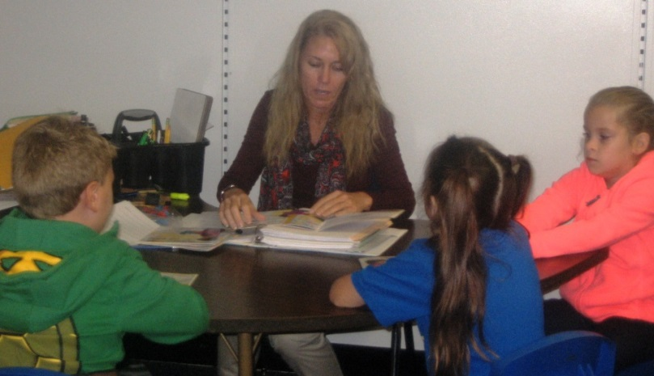
Guided Reading
During guided reading, teachers work with students to guide them in using their emerging reading strategies. By using books that gradually increase in difficulty, students work at their own levels and feel very successful! The end goal is for students to become confident, proficient readers who LOVE to read!
Notes:
Guided Reading

Slide 11
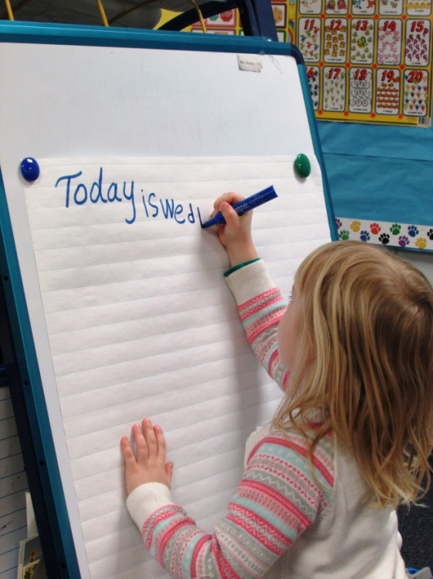
Interactive Writing
This is a time where we share the marker, tap out sounds, and write important labels to use in the classroom.
Notes:
Independent Reading / Reading Workshop

Slide 12
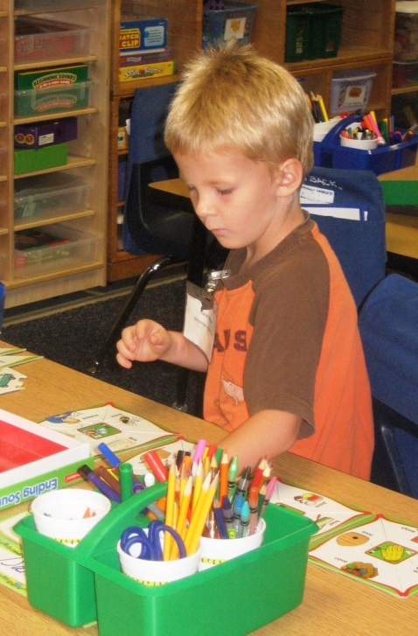
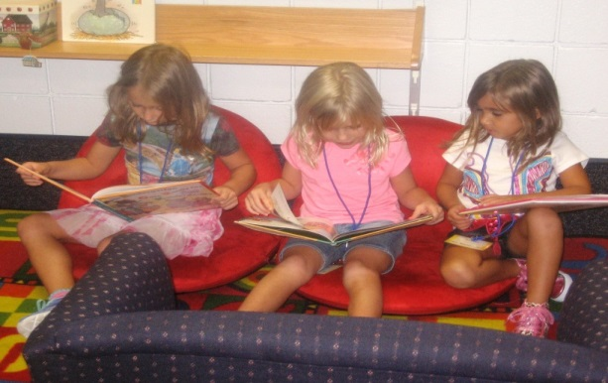
Word Work & Literacy Centers
Word Work & Literacy Centers provides meaningful reading and writing experiences as students work to apply skills and strategies learned during shared and guided reading lessons.
Typical word work/literacy center activities
may include ABC practice, word building, writing, listening center, computer center, and reading around the room.
Notes:
Literacy Stations - Hands on literacy work

Slide 13
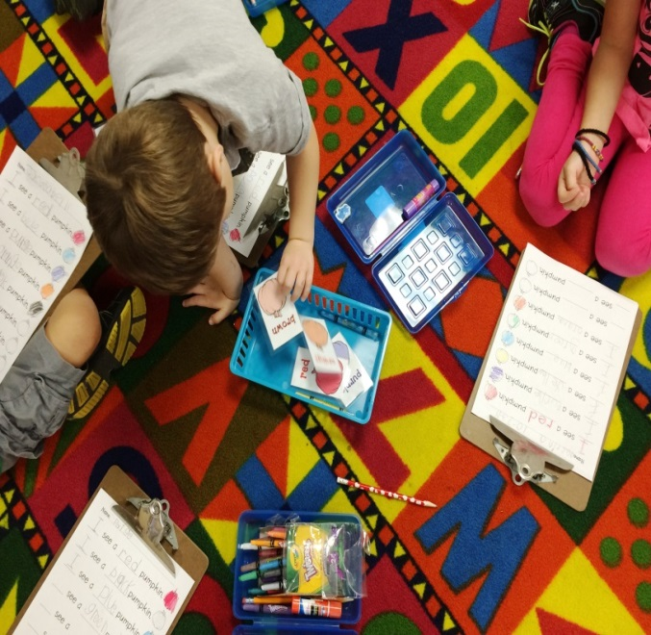
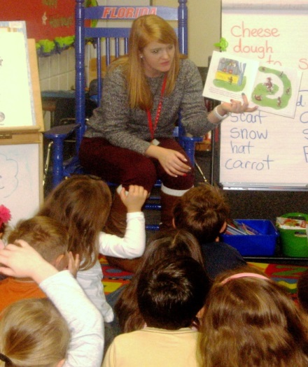
Read A-Louds
Students experience the joy in being able to listen to a story and then talk about what they have heard and learned. Active engagement in Read A louds is paramount to listening comprehension and vocabulary development.
Multi-sensory activities promote phonics, phonemic awareness and handwriting skills.
Notes:
Phonics / Handwriting/ Project Read

Slide 14
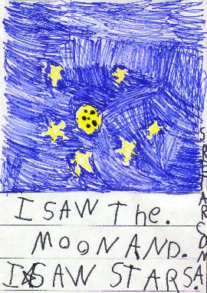
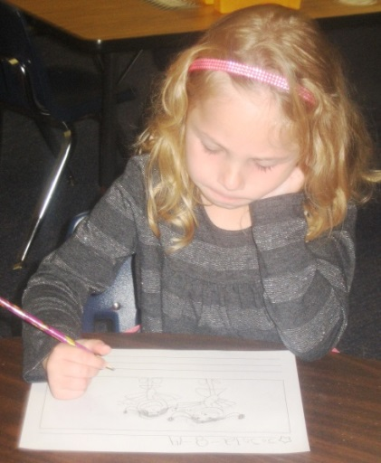
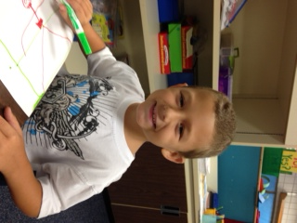
Writing Workshop
Children have a lot to say about the world and they can express themselves on paper through inventive spelling and drawing.
Writing Workshop builds on the children’s strengths, provides meaningful, structured opportunities to write, exposes them to beautiful literature and actively teaches the skills and strategies that writers need.
Notes:
Writing Workshop

Slide 15
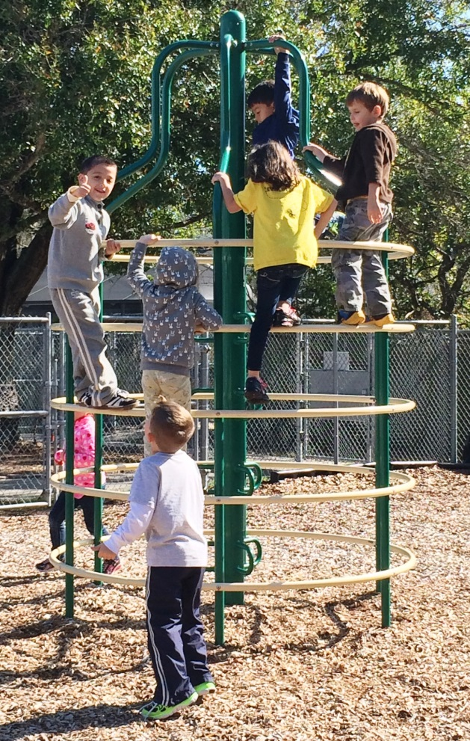
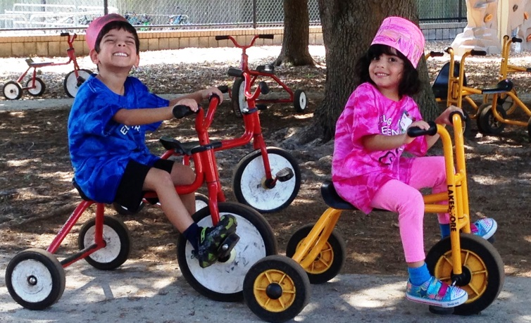
Recess
Children learn important social skills on the playground. Recess helps to develop skills such as cooperating, helping, sharing, and problem solving.
Notes:
Recess

Slide 16
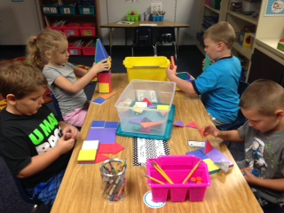
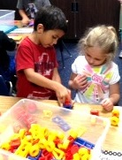
Math
Kids participate in whole-group and small group math lessons daily.
The children do many hands-on activities involving counting, numeration, measurement, geometry, sorting, adding, subtracting and data collection.

Slide 17
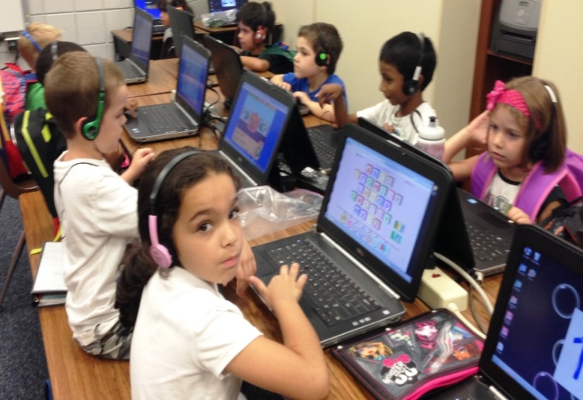
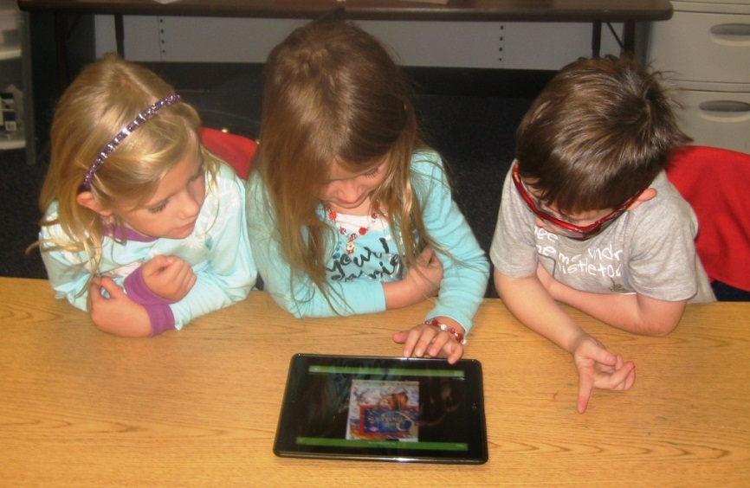
Technology we will give a chance to explore and use computers for different projects – creating and writing and making thinking visible.
Notes:
Science - experimentation and discovery

Slide 18
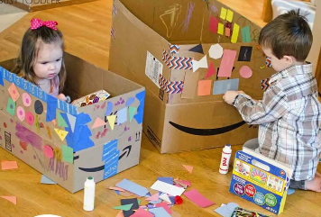
Choice Time
During choice time the kids have a chance to further develop their social skills. They practice teamwork, taking turns and problem solving.
Notes:
Specials - Music - 2x a week

Slide 19
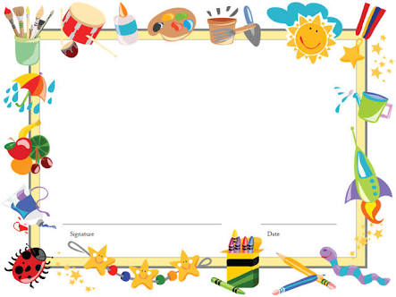
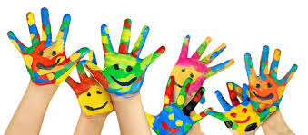
We look forward to welcoming you to Tom and Jerry
Notes:
The End

